Slide 1
🛡
AI-Powered Web & File Security Shield
Team Members:
C.Guruteja - 22191A0507
B.Sravanthi - 22191A0536
K.Nani - 22191A0558
Zero-Day Threat Detection • Real-Time ML Analysis • Chrome Extension
Under the Guidance of:
Dr.K.Balachandra Reddy _{M.Tech,Ph.D.}
Assistant Professor
Department of CSE, JNTUACEP.
Head of the department :
Dr. S. Jessica Saritha _{M.Tech,Ph.D.}
Associate Professor
Department of CSE, JNTUACEP
Proactive • Intelligent • Relentless

Slide 2
THE PROBLEM
Why Traditional Security Fails
⛔
⚡
📉
Blacklist-Based Detection
Zero-Day Vulnerabilities
Reactive, Not Proactive
Traditional AV relies on known threat signatures. New phishing domains go live every minute — blacklists are always one step behind.
Newly crafted phishing URLs evade detection entirely. Users remain exposed for hours or days before databases are updated.
Legacy tools only react after a threat is identified. By then, credentials are stolen and damage is done.
PhishShield addresses all three failure points simultaneously.

Slide 3
THE SOLUTION
PhishShield: Proactive ML-Powered Defense
A Chrome Extension that runs silently in the background, analyzing every URL and file download in real-time using a trained XGBoost machine learning model.
No waiting for database updates 90.5% detection accuracy Fully logged to admin dashboard
Chrome Extension
Client Interface
FastAPI Backend
ML Brain
React Dashboard
Analytics Center
3-TIER ARCHITECTURE

Slide 4
MACHINE LEARNING
XGBoost Model & Feature Engineering
90.5%
🔗 URL-Based Features
🌐 Webpage/HTML Features
URL Length
Domain Length
Letter-to-Digit Ratio
Abnormal URL patterns
Redirect count
Special character density
JS/CSS file count
Iframe count
Popup presence
Submit button count
Copyright info presence
Internal vs External links
Detection Accuracy
30+
URL Features Extracted

Slide 5
FILE SECURITY
1
2
⬇️ Download Initiated
📤 Payload Sent
User uploads a file.
File content or metadata/hash is securely transmitted to the FastAPI backend for deep analysis.
3
4
🔐 SHA-256 Hashing
🚨 Verdict & Action
Backend generates a SHA-256 hash and cross-references against known malicious signatures and patterns.
Risk score >90%:shows alert and threat logged. Safe files proceed normally. Admin dashboard updated instantly.

Slide 6
TECH STACK
Extension
Frontend
Dashboard
Frontend
Backend
Server
ML &
Database
JavaScript
HTML5 / CSS3
Chrome APIs
React + TypeScript
Tailwind CSS
REST API client
Python 3.11+
FastAPI
Uvicorn
XGBoost
Scikit-Learn
Pandas / NumPy
SQLite

Slide 7
WORKFLOW
A) Url Workflow — End to End
🌐
📡
🧮
🤖
🚫
📋
1
2
3
4
5
6
User Browses
URL Captured
Feature Extraction
ML Inference
Alert
Threat Logged
Extension silently monitors traffic in background. No friction.
POST request sent to /api/scan-url with raw URL payload.
URLFeatureExtractor generates 30+ numerical features in milliseconds.
scaler.pkl normalizes data → xgb_model.json predicts & scores.
Phishing: Red warning page shown. Green:safe page shown.
Result, timestamp, risk score appear on React dashboard instantly.

Slide 8
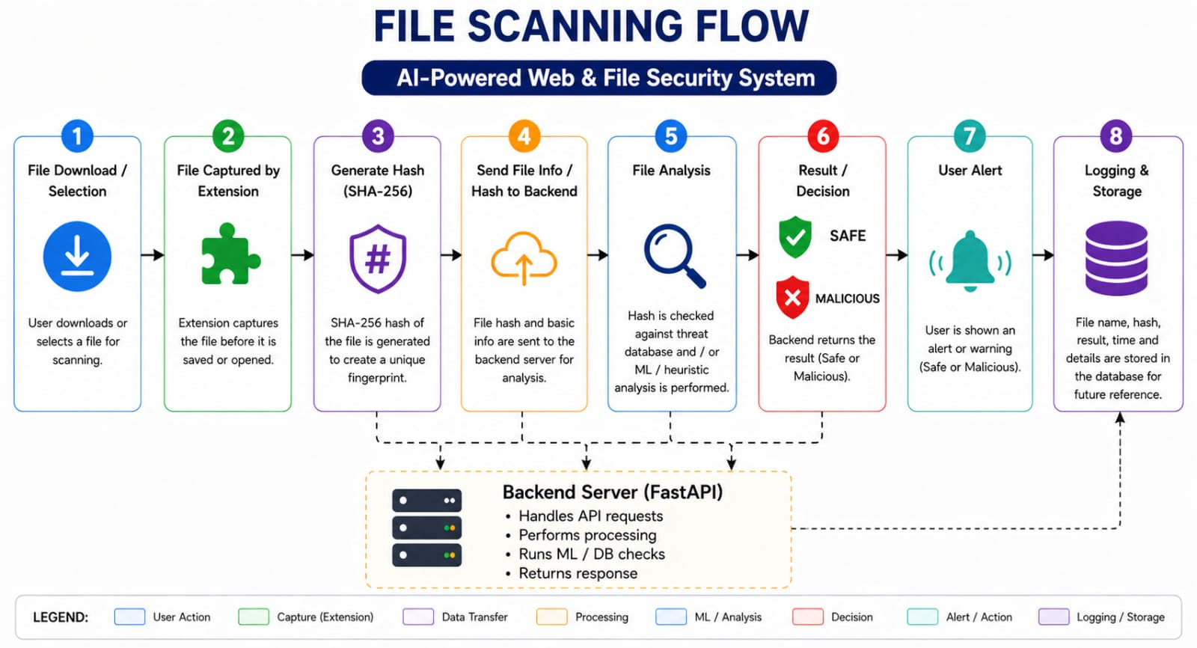
B) File Scan Workflow – End to End:

Slide 9
Model Comparision Table:
Model | Accuracy | Precision | Recall | AUC-ROC
Logistic Regression | 87.2% | 86.5% | 87.8% | 0.877
Decision Tree | 91.4% | 90.9% | 91.9% | 0.934
Random Forest | 95.8% | 95.4% | 96.1% | 0.981
SVM (RBF kernel) | 93.1% | 92.7% | 93.5% | 0.968
XGBoost (Proposed) | 96.5% | 95.4% | 96.7% | 0.997

Slide 10
🛡
Key Achievements
🎯
90.5% Accuracy
PhishShield
XGBoost model on 30+ engineered features
⚡
Real-Time Analysis (Extension)
AI-Powered Security
for the Modern Web
Sub-second URL scanning on every page load
🔒
Full File Protection
SHA-256 hash checking with Alert
📊
Live Admin Dashboard
Powered analytics with extension heartbeat
🧠
Zero-Day Ready
ML-based, not reliant on signature databases

Slide 11

Output

Slide 12
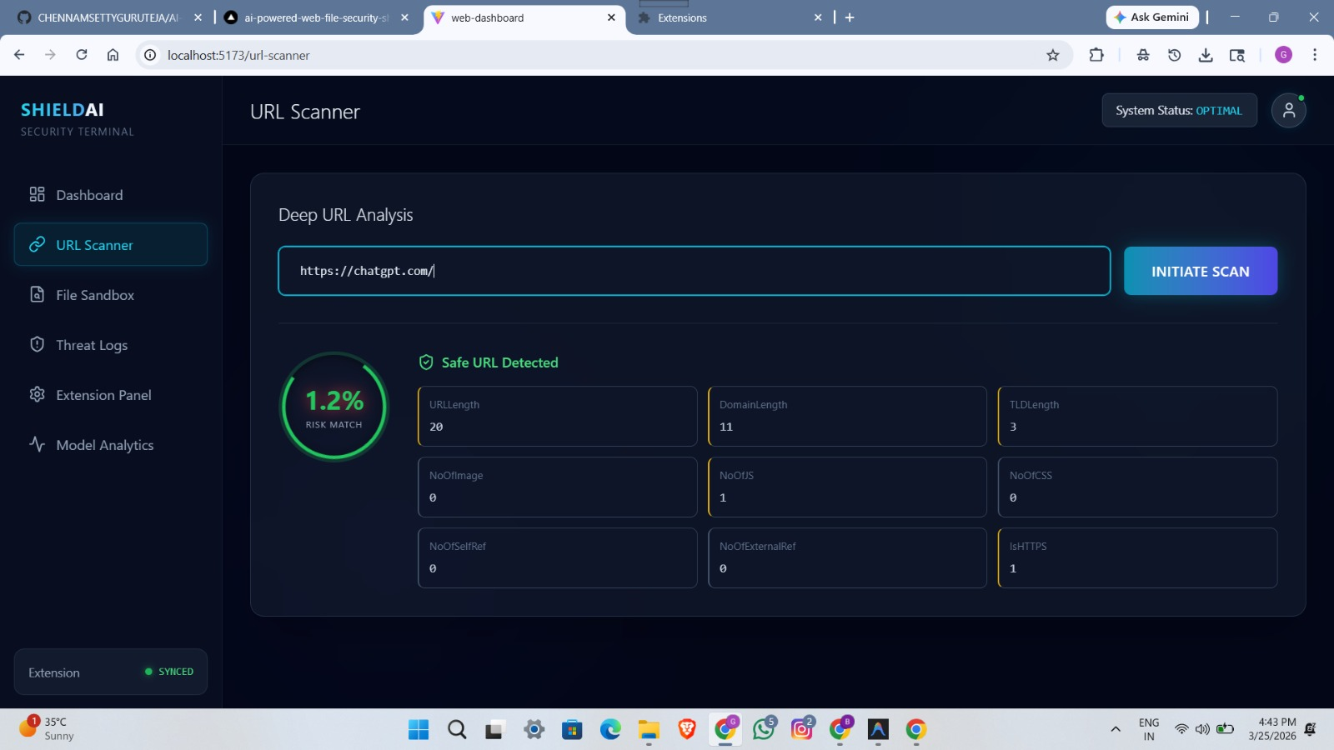
URL Analysis

Slide 13
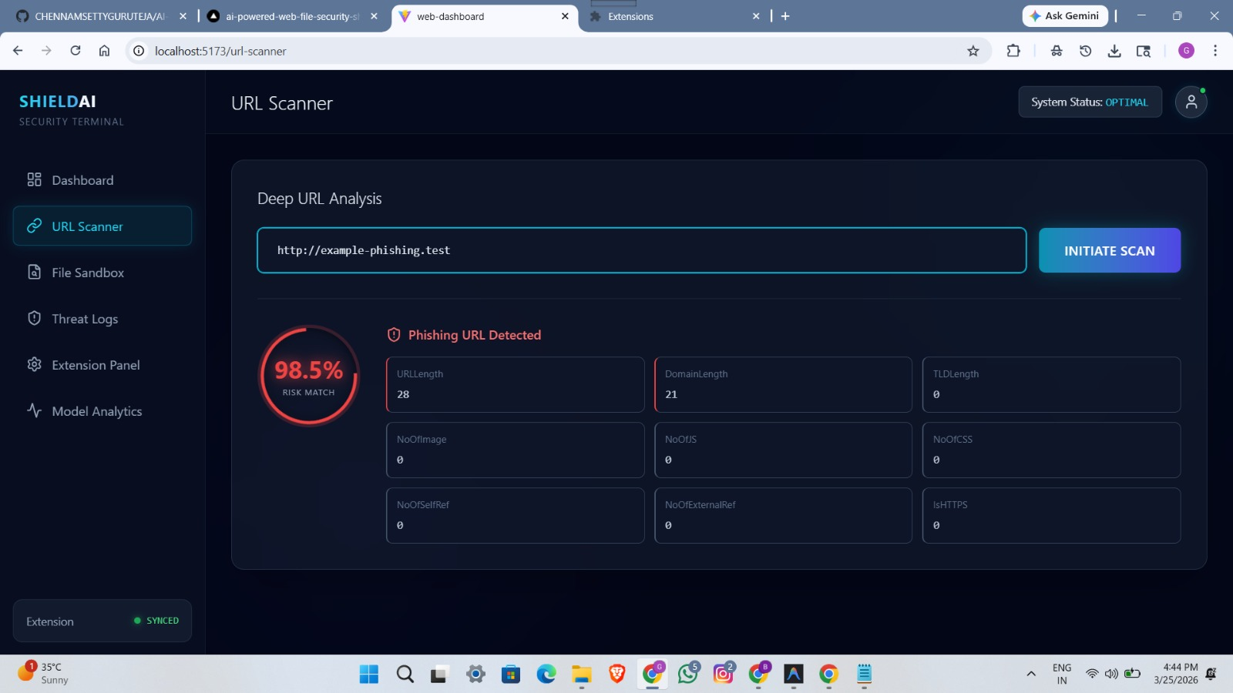

Slide 14
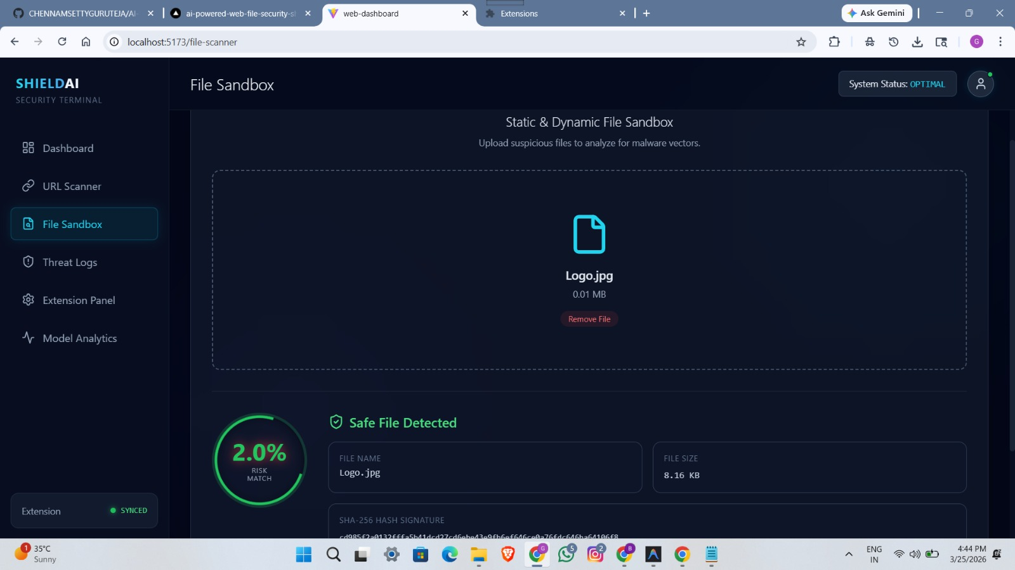
File Scan

Slide 15
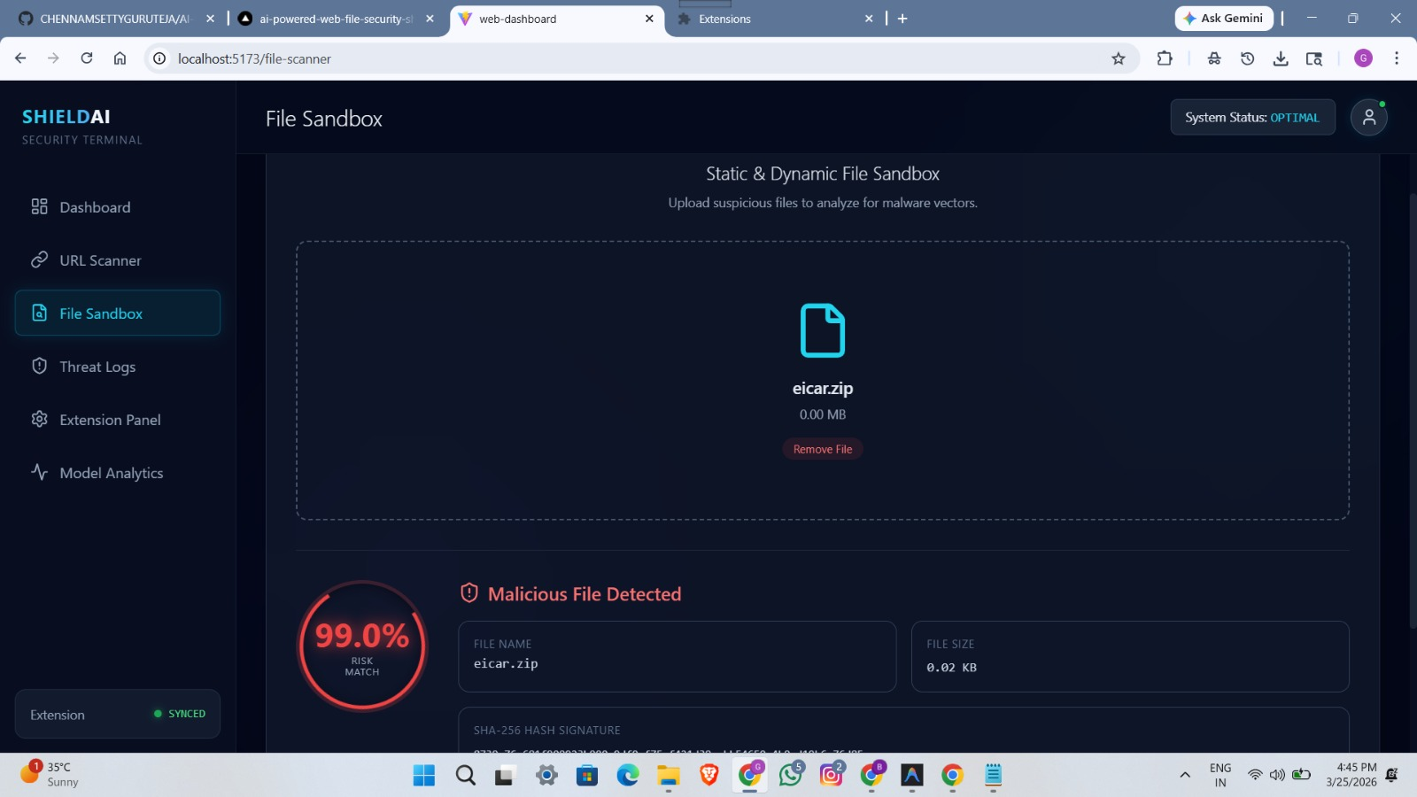

Slide 16
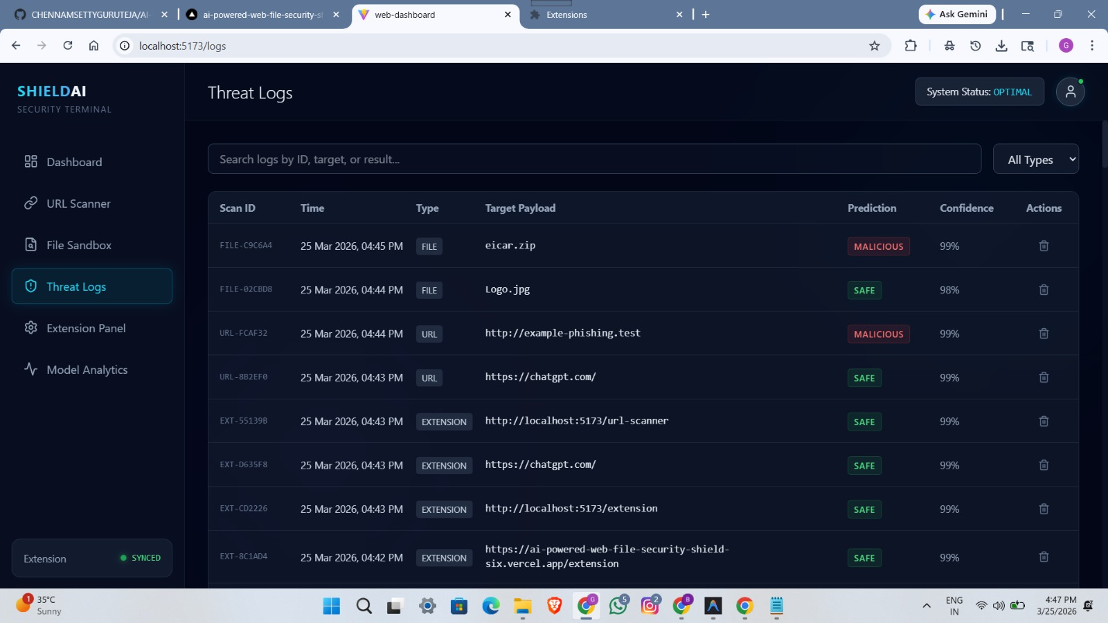
Logs

Slide 17
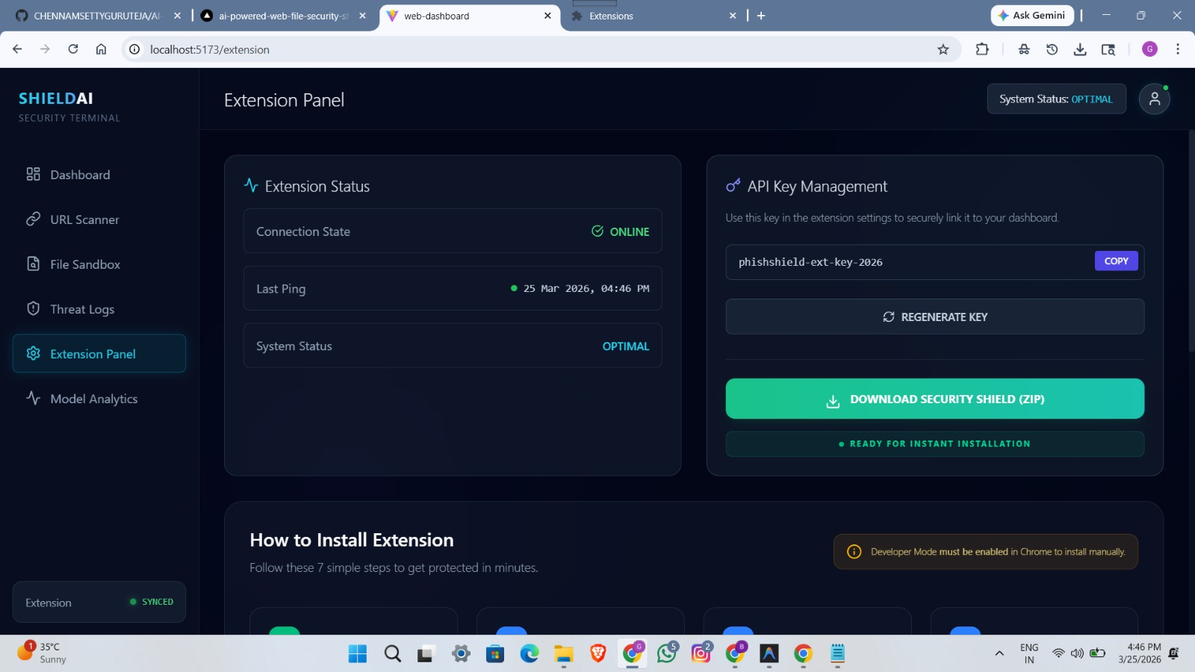
Extension

Slide 18
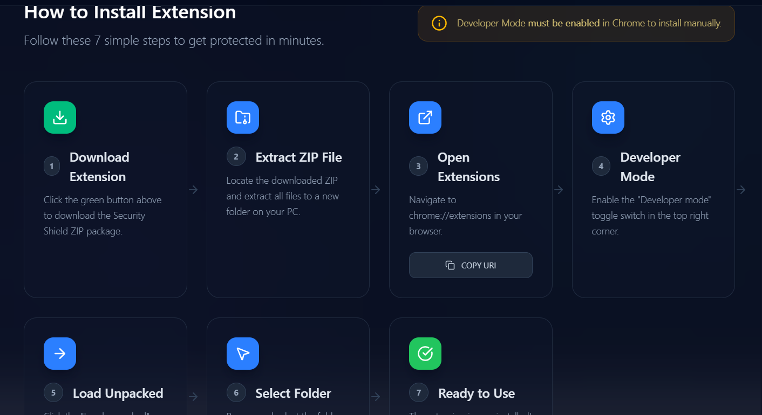

Slide 19
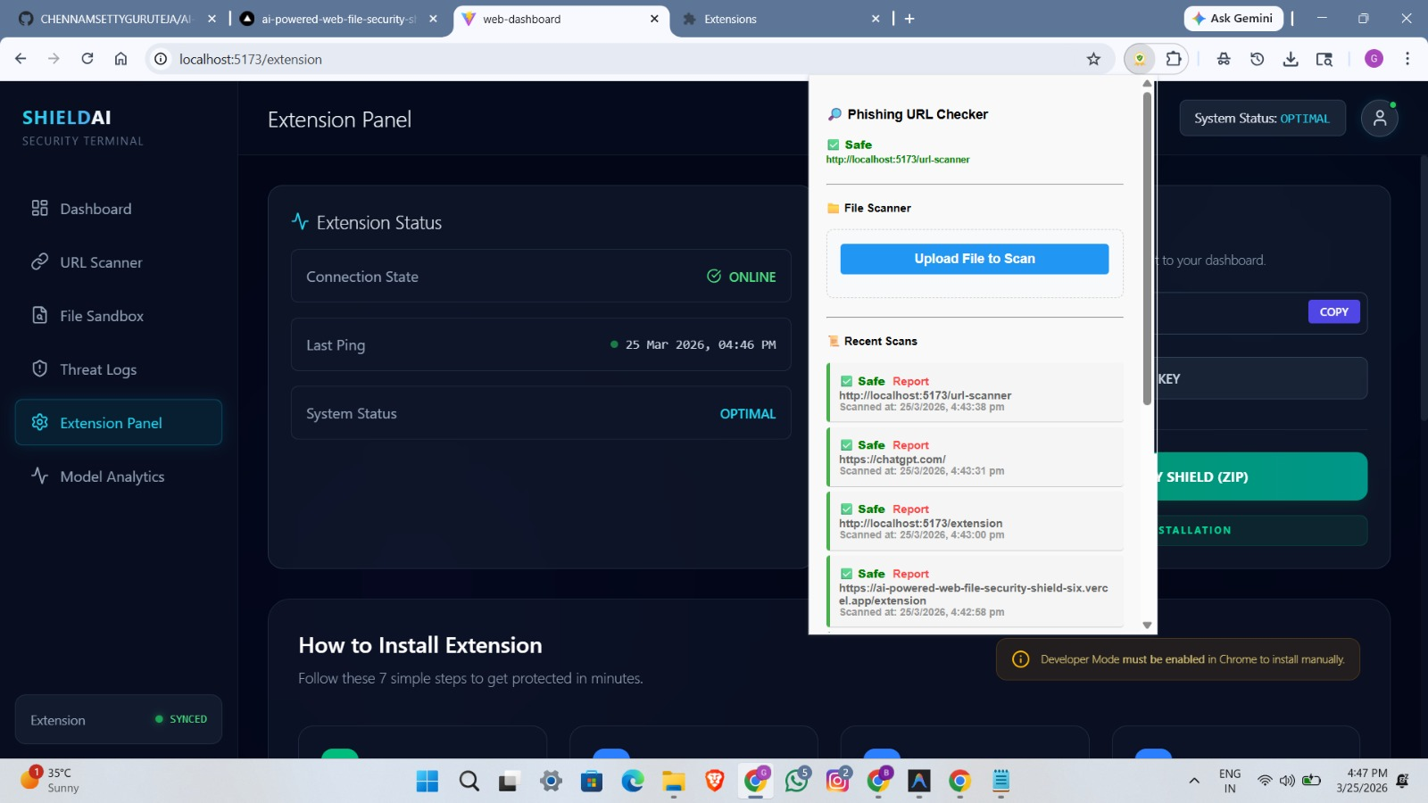

Slide 20
Conclusion:
The AI-Powered Web & File Security System detects phishing websites and malicious files in real time using Machine Learning. It provides a lightweight and efficient security solution without affecting system performance.
Key Points
Detects both malicious URLs and files
Uses Machine Learning for accurate prediction
Provides real-time alerts to the user
Ensures low latency and efficient performance

Slide 21


Slide 22


Slide 23


Slide 24


